Slide 1
Surviving the ODOT Review: The Wonder Years 2018-2022
Ernie Tischhauser MAI

Slide 2
A Lot of Changes in Our World.
Covid pandemic
Stimulus
Meteoric rise of housing and industrial markets
Rising construction costs
International Conflict
Inflation
Rising interest rates

Slide 3
What This Presentation is Not
It is not a comprehensive study of all Aspects of appraising;
It is not ODOT Policy!
One more time….It is not ODOT Policy!

Slide 4
What This Presentation is
A compilation of Appraisal Issues that have caused revisions over the past 5 years…and how to address them.

Slide 5
ODOT Review Objectives
Ensure property owner receives just compensation;
Reduce or Eliminate Revisions;
“The State insists upon the highest quality of appraisal products to assure that the citizenry of Oregon and the individuals from whom we acquire property are treated in a fair and honest manner. Key to the appraisal process is to properly understand the scope of the appraisal assignment and utilizing the proper report form for communicating the appraisal result”

Slide 6
Most Recent Major Project Results
Achieved 1 revision or less 41% of the time;
Roughly 73% of files had two or less revisions;
Roughly 5% of files required more than 5 revisions;
The average number of revisions was 2.86 revisions per file.

Slide 7
Structure of Presentation Content
Identification of the appraisal issue causing the revision;
Best practices to address it.

Slide 8
Front-End of the Report

Slide 9
Legal Description Changes
Expansion, Contraction or change in the type of acquisitions.

Slide 10
Legal Description Changes, Cont’d
May not require a new inspection (Discuss with PM or Review);
If no follow up inspection, narrative must explain why date of value precedes description date and how the previous inspection captured the impact of the acquisition(s);
If new inspection, must include pictures.

Slide 11
Pictures
Insufficient number of pictures to define larger parcel and acquisition areas

Slide 12
Pictures, Cont’d
Should include a wide-shot of the larger parcel;
Perspective on all of the acquisition areas
Read the Guide to Appraising Real Property (word search Photos)

Slide 13
Area of the Larger Parcel
Larger parcel area estimate doesn’t match Remainder Calculation, Sketch or Addendum

Slide 14
Area of the Larger Parcel, Cont’d.
GARP suggests that using the ODOT provided site area information is the “most defensible”;
If different than ODOT sketch, disclose the source of the area calculation (Assessor, Plat Map, etc);
Super Pro Tip!! State whether the difference between ODOT source and appraisal source had material impact on value.

Slide 15
Description of the Taking
No explanation of what the acquisition areas will look like after the Project.

Slide 16
Description of the Taking, Cont’d
Narrate details of construction plans in the report;
Include plans in the report to provide greater clarity to the reader;
Super Pro Tip!! Ask PM and Engineer to explain what area will look like and drop it in the report.

Slide 17
Existing Easements
Report fails to specify the quantity and type of existing easements in the acquisition area.

Slide 18
Existing Easements, Cont’d
Use the Addendum as a guide;
Double check the Addendum with the Sketch and the PTR;
List all impactful easements in the report (Usually by PTR Exceptions);
If in doubt, Ask Review or PM for help;
Super Pro Tip!! Make statement as to the impact of encumbrance on LP or Acquisition

Slide 19
ODOT Certificate
Includes two different dates at the top and the bottom;
Includes a different value than stated in the final allocation sheet

Slide 20
ODOT Certificate, cont’d
Both dates in Certificate should be the valuation date;
Report date is at the very bottom next to your name.
Super Pro Tip!!! Do a word search of your previous value amount to make sure that the certificate is updated

Slide 21
Five Year Sales History
No discussion of recent transfers of the larger parcel.

Slide 22
Five Year Sales History, Cont’d
Confirm any transfers within the past 5 years;
Report whether any of the sales were market transactions;
Super Pro-Tip!: Make a statement that the valuation reconciles with the recent sale price.
Especially if this is vacant land

Slide 23
Neighborhood Description
Neighborhood description is too short.

Slide 24
Neighborhood Description, Cont’d
Include a market overview;
Include demographic and employment information;
Include transporation support.
Super Pro Tip!! Include a summary statement about the desirability of the neighborhood and marketplace.

Slide 25
Description of the Remainder
No explanation of the functionality of the site during and after the project.

Slide 26
Description of the Remainder
Itemize the areas of impact and include a clarifying statement regarding functionality
If no major impacts, still include a clarifying statement regarding functionality.

Slide 27
Highest and Best Use
No reference to highest and best use as-vacant or as-Improved

Slide 28
Highest and Best Use, Cont’d
Do I really have to say it….Put it in there!
If you already detail the use in the report, go ahead and reference the “current use”
If you need a good template for this, ask Review and we can help.

Slide 29
Valuation Issues

Slide 30
Unit Value
Applying the wrong unit value.

Slide 31
Unit Value, Cont’d
Industial/commercial land: $/SF or $/FAR SF;
MF land is recognized by $/Door or $/SF;
Residential development land is $/Raw Lot or $/ACRE;
Single family homesite is $/Homesite;
Ag Land is all over the place depending on acquisition area.

Slide 32
Quantitative Adjustments to Sales
No explanation of market trend
Clearly problematic if your sales go back to 2018.

Slide 33
Quantitative Adjustments to Sales, Cont’d
Fee appraisers are required to consider market trend. At the very least include a statement as to what sources you considered in making a market trend adjustment (paired sales, Costar analytics, RMLS sales data, PwC, other published surveys, etc)
If you are going to make an adjustment, make sure that the reader can follow it
Make sure chart includes reference to the inputs.

Slide 34
Quantitative Adjustments to Sales, Cont’d
No adjustment for improvements on sales
Improved properties have a different motivation for purchasers which may influence land value contribution.

Slide 35
Quantitative Adjustments to Sales, Cont’d
If you include improved sales:
Clearly disclose the purchase motivation
If extracting land value, state the source and reliability of the adjustment (Assessor data only counts if the market relies upon it);
Consider adjustment for demolition of improvements in site value.

Slide 36
Valuation Date
Valuation date is not reflective of current market conditions.

Slide 37
Valuation Date, Cont’d.
If volatile market conditions exist you may be required to update the valuation date;
Be mindful of the valuation date;
Communicate with Review if your valuation date is approaching 3 months.

Slide 38
Value of Low-Utility Areas
No recognition of low-utility areas in a larger parcel
The acquisitions may reside in areas that do not carry the same intrinsic value as others

Slide 39
Value of Low-Utility Areas, Cont’d.
Clearly discuss how the market would define these areas and allocate appropriately;
Compare with sales of low-utility sites to understand how the market reacts to these areas on an individual basis;
Consider adjusting value based upon the same principles which govern permanent easement valuations

Slide 40
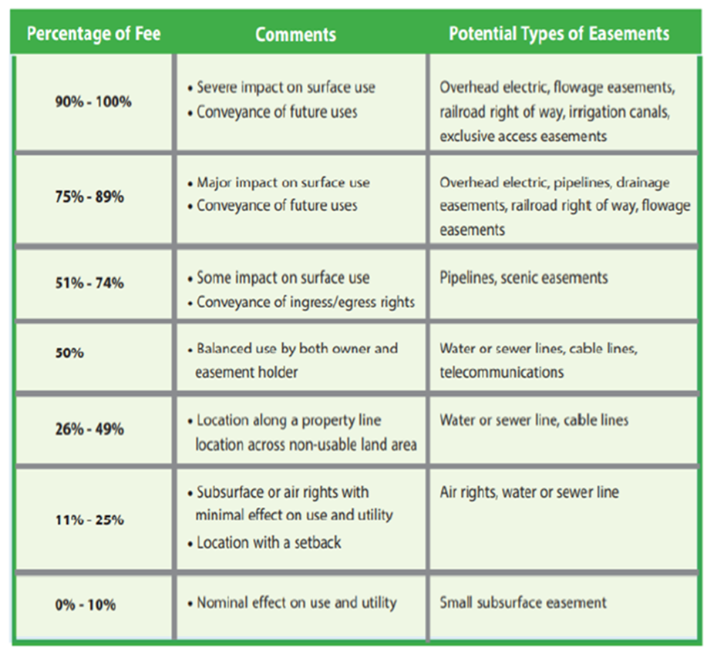
Valuation of Permanent Easements
I know you have seen this graph.

Slide 41
Valuation of Permanent Easements, Cont’d
Do not make this your only source of adjustment to fee value;
Consider paired sales analysis, experience, market interviews, etc;
Guidance for this is found in the “Guidelines for the Appraisal Of Easements”

Slide 42
Valuation of Permanent Easements, Cont’d.
The adjusted value does not reconcile with valuation of existing easements

Slide 43
Valuation of Permanent Easements, Cont’d.
If the impact of an existing easement has diminished over time explain why this has occurred
Perhaps the market has incorporated the easement into efficient commercial development.
Perhaps all of the competing properties reflect similar existing easements

Slide 44
Valuation of Temporary Easements
Value of overlapping area is not recognized and applied appropriately.

Slide 45
Valuation of Temporary Easements, Cont’d.
Make sure that you reduce fee value by the amount paid for an overlapping easement
For example, if you paid 50% of $10 for a PE for Slopes that overlaps a TE for Work area, that area should only be valued at $5/SF in the TE calculation

Slide 46
Signs
Salem we have a problem!

Slide 47
Signs, Cont’d
Request the approved Sign Report Review from the PM
Contact review with questions

Slide 48
Before and After Appraisal
Lack of market data to support “After Condition” Value
Could lead to an Appraiser recognizing only potential damage and not true damage of the acquisitions

Slide 49
Before and After Appraisal, Cont’d
Income Approach, recognize not only potential loss in income attributed to the take but the potential for a new risk profile of the property (Capitalization rate);
Developing value based upon the remainder’s characteristcs creates a “backstop” to any potential damages

Slide 50
Valuation of Site Improvements
High dollar site improvements

Slide 51
Valuation of Site Improvements, Cont’d
High dollar or complex site improvements require a bid from a contractor;
Any value amount above $10,000 should have the bid included in the addenda;
If no contractor (rare occasions), detailed steps of how value was confirmed

Slide 52
Damages and Cost to Cure
No summary statement clarifying why no damages accrue to the remainder.

Slide 53
Damages and Cost to Cure
Categorize and summarize why there are no damages:
Access is retained;
Use is retained
Functionality is retained.
Super Pro Tip!! In residential or multifamily development land, reconcile that the value of any lost units was covered by the fair market value;
Super Super Pro Tip!! Confirm that near term development of vacant land will not be delayed by the project.

Slide 54
Damages and Cost to Cure
Super Pro Tip!! In residential or multifamily development land, reconcile that the value of any lost units was covered by the fair market value;
Super Super Pro Tip!! Confirm that near term development of vacant land will not be delayed by the project.

Slide 55
Final Thoughts and Considerations
Proofread your narrative to check for grammar, spelling and that you are conveying a coherent message;
Double check calculations and reporting of calculations;
Double check the narrative against the chart;
Super-Duper Pro Tip!! Contact Review if you have any doubts about your valuation.

